Slide 1

Domain: Flight Travel Agency Service. Task: Perform whether flight will be delayed or not.
Project - Big Data Analytics and Visualization

Slide 2
Problem Statement

Slide 3
Business Requirement
Sky Travel (ST) provides concierge services for business travelers. In an increasingly crowded market, they are always looking for ways to differentiate themselves and provide added value to their corporate customers.
ST is investigating ways that they can capitalize on their existing data assets to provide new insights that provide them a strategic advantage against their competition. In planning their product, they heard much fanfare about machine learning and came up with the idea of using predictive analytics to help customers best select their travels based on the likelihood of a delay. When reviewing their customer transaction histories, they discovered that their most premium customers often book their travel within 7 days of departure. In speaking with customer service, they learned that these customers often ask questions like, "I don't have to be there until Tuesday, so is it better for me to fly out on Sunday or Monday?"
While there are many factors that customer service uses to tailor their guidance to the customer (such as cost and travel duration), ST believes an innovative solution might come in the form of giving the customer an assessment of the risk of encountering flight delays. For low-risk flights, the customer may choose to book flight, giving them more precious time at home and less on the road spent arriving too early to a destination. ST is interested in applying data science to the problem to discover if the weather forecast coupled with their historical flight delay data could be used to provide a meaningful input into the customer's decision-making process.

Slide 4
Business Requirement
1. Generate detailed reports that can be visualized in a dashboard. The detailed reports can include tables that are a subset or findings from the dataset.
2. Build an automized solution using machine learning models whether flight will be delayed or not.
3. Create scheduled pipeline for new data arriving.

Slide 5
Dataset
1. 'FlightDelaysWithAirportCodes.csv'
It contains information about the historical flight delays.
2. 'FlightWeatherWithAirportCode.csv'
It contains all the information of the weather corresponding to flight delays.
3. 'AirportCodeLocationLookupClean.csv’
It contains all the information regarding Airport.

Slide 6
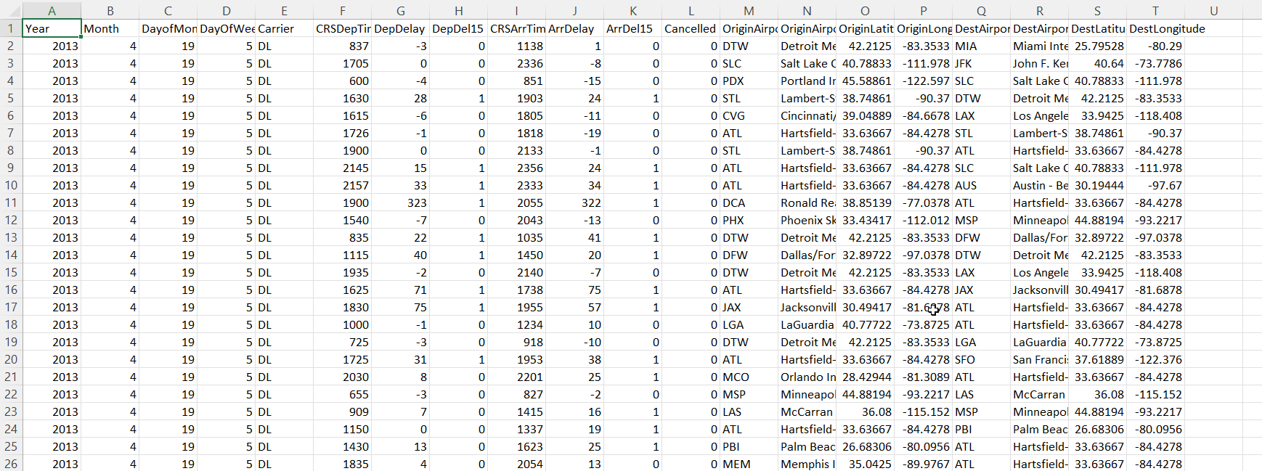
Snapshots of Dataset: 'FlightDelaysWithAirportCodes.csv'

Slide 7
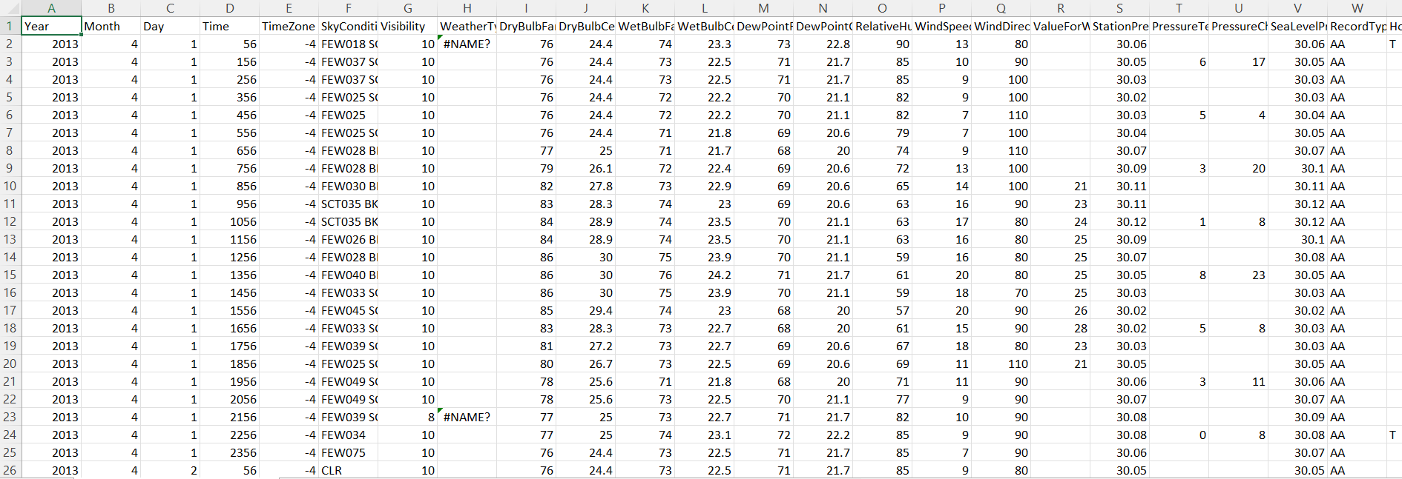
Snapshots of Dataset: 'FlightWeatherWithAirportCode.csv'

Slide 8
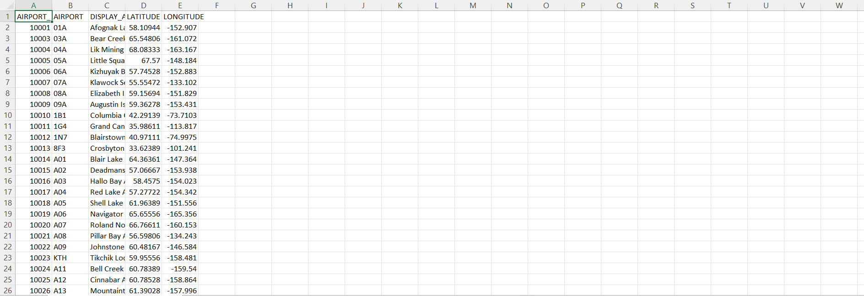
Snapshots of Dataset: 'AirportCodeLocationLookupClean.csv'

Slide 9
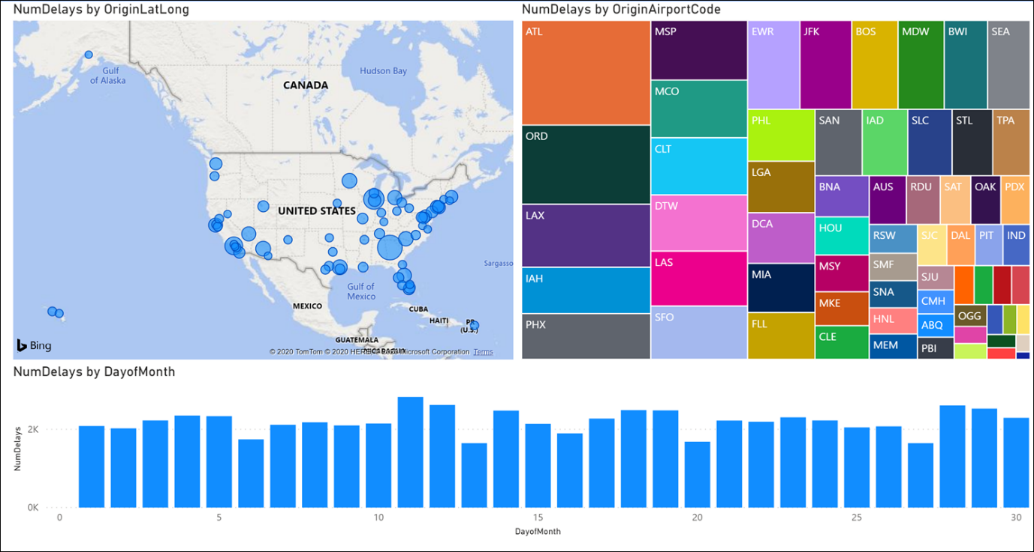
Sample visualizations

Slide 10
Step 1
Understand the business problem.
Understanding the columns of the dataset and identify the target variable.
Formulate the objectives to accomplish the business problem.
Prepare a solution plan for solving the problem.
Submissions: A ppt comprising objectives (for both business requirements), and a high-level block diagram representing the solution. Selected candidates will be presenting the ppt from 1:00 PM

Slide 11
Step 2
Identify the Azure services required to implement the solution.
Develop the architecture to solve the problem using services of Azure.
Make a list of operations/actions to be performed to accomplish the solution.

Slide 12
Thank You

